Slide 1
Bucket Sorting

Slide 2
Bucket Sort
Bucket sort assumes that the input is generated by a random process and drawn from a uniform distribution.
In other words the elements are distributed uniformly and independently over the interval [0,1].
Bucket sort divides the interval [0,1] into n equal sized subintervals or buckets. Then distributes the n inputs into these buckets.
After that the elements of each buckets are sorted using a sorting algorithm generally using insertion or quick sort.
Finally the buckets are concatenated together in order.
Consider that the input is an n-element array A and each element A[i] in the array satisfies the 0<=A[i]<1

Slide 3
Bucket Sort Algorithm
Bucket-Sort(A)
Let B[0….n-1] be a new array
n = length[A]
for i = 0 to n-1
make B[i] an empty list
for i = 1 to n
do insert A[i] into list B[ ⎣ n A[i] ⎦ ]
for i = 0 to n-1
do sort list B[i] with Insertion-Sort
Concatenate lists B[0], B[1],…,B[n-1] together in order

Slide 4
Bucket
1 | 2 | 3 | 4 | 5 | 6
A
.74 | .17 | .26 | .72 | .39 | .21

Slide 5
Bucket: Loop 1
n=6
1 | 2 | 3 | 4 | 5 | 6
A
.74 | .17 | .26 | .72 | .39 | .21
0 | 1 | 2 | 3 | 4 | 5
B

Slide 6
Bucket: Loop 2
FOR n=6, i=1
1 | 2 | 3 | 4 | 5 | 6
A
.74
 | .17 | .26 | .72 | .39 | .21
B[ ⎣ n A[i] ⎦ ] = B[ ⎣ 6X.74 ⎦ ]=B[ ⎣ 4.44 ⎦ ]=B[4]
0 | 1 | 2 | 3 | 4 | 5
B

Slide 7
Bucket: Loop 2
FOR n=6, i=2
1 | 2 | 3 | 4 | 5 | 6
A
.17
.74 |  | .26 | .72 | .39 | .21
B[ ⎣ n A[i] ⎦ ] = B[ ⎣ 6X.17 ⎦ ]=B[ ⎣ 1.02 ⎦ ]=B[1]
.74
0 | 1 | 2 | 3 | 4 | 5
B

Slide 8
Bucket: Loop 2
FOR n=6, i=3
1 | 2 | 3 | 4 | 5 | 6
A
.26
.74 | .17 |  | .72 | .39 | .21
B[ ⎣ n A[i] ⎦ ] = B[ ⎣ 6X.26 ⎦ ]=B[ ⎣ 1.56 ⎦ ]=B[1]
.74
.17
0 | 1 | 2 | 3 | 4 | 5
B

Slide 9
Bucket: Loop 2
FOR n=6, i=4
1 | 2 | 3 | 4 | 5 | 6
A
.72
.74 | .17 | .26 |  | .39 | .21
B[ ⎣ n A[i] ⎦ ] = B[ ⎣ 6X.72 ⎦ ]=B[ ⎣ 4.32 ⎦ ]=B[4]
.26
.74
.17
0 | 1 | 2 | 3 | 4 | 5
B

Slide 10
Bucket: Loop 2
FOR n=6, i=5
1 | 2 | 3 | 4 | 5 | 6
A
.39
.74 | .17 | .26 | .72 |  | .21
B[ ⎣ n A[i] ⎦ ] = B[ ⎣ 6X.39 ⎦ ]=B[ ⎣ 2.34 ⎦ ]=B[2]
.26
.74
.17
.72
0 | 1 | 2 | 3 | 4 | 5
B

Slide 11
Bucket: Loop 2
FOR n=6, i=6
1 | 2 | 3 | 4 | 5 | 6
A
.94
.74 | .17 | .26 | .72 | .39
B[ ⎣ n A[i] ⎦ ] = B[ ⎣ 6X.94 ⎦ ]=B[ ⎣ 5.64 ⎦ ]=B[5]
.26
.74
.17
.39
.72
0 | 1 | 2 | 3 | 4 | 5
B

Slide 12
Bucket: End of Loop 2
1 | 2 | 3 | 4 | 5 | 6
A
.74 | .17 | .26 | .72 | .39 | .94
.26
.74
.39
.94
.17
.72
0 | 1 | 2 | 3 | 4 | 5
B

Slide 13
Bucket: Loop 3
Apply insertion sort on each bucket
1 | 2 | 3 | 4 | 5 | 6
A
.74 | .17 | .26 | .72 | .39 | .94
.17 | .26
.39
.72 | .74
.94
0 | 1 | 2 | 3 | 4 | 5
B

Slide 14
Bucket
Concatenate the buckets in order
1 | 2 | 3 | 4 | 5 | 6
A
.74 | .17 | .26 | .72 | .39 | .94
Sorted output
0 | 1 | 2 | 3 | 4 | 5
B
.17 | .26 | .39 | .72 | .74 | .94
.17 | .26
.39
.72 | .74
.94
0 | 1 | 2 | 3 | 4 | 5
B

Slide 15
Example - Bucket Sort
A
1
.78
.17
.39
.26
.72
.94
.21
.12
.23
.68
B
0
/
2
1
.17
.12 /
3
2
.26
.21
.23 /
4
3
.39 /
5
4
/
Distribute
Into buckets
6
5
/
7
6
.68 /
8
7
.78
.72 /
9
8
/
10
9
.94 /

Slide 16
Example - Bucket Sort
0
/
1
.12
.17 /
2
.21
.23
.26 /
3
.39 /
Sort within each
bucket
4
/
5
/
6
.68 /
7
.72
.78 /
8
/
9
.94 /

Slide 17
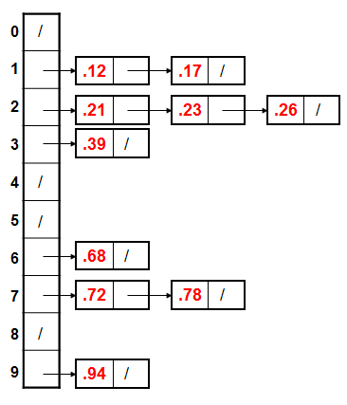
Example - Bucket Sort
.12
.17
.21
.23
.26
.39
.68
.72
.78
.94 /

Slide 18
Bucket Sort Review
Assumption: input is uniformly distributed across a range
Basic idea:
Partition the range into a fixed number of buckets.
Toss each element into its appropriate bucket.
Sort each bucket.
Pro’s:
Fast
Asymptotically fast (i.e., O(n) when distribution is uniform)
Simple to code
Good for a rough sort.
Con’s:
Doesn’t sort in place

Slide 19
Selection Sort

Slide 20
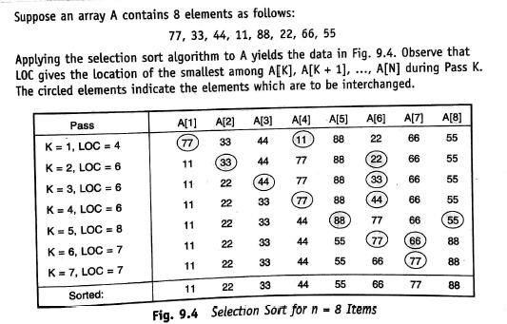

Slide 21
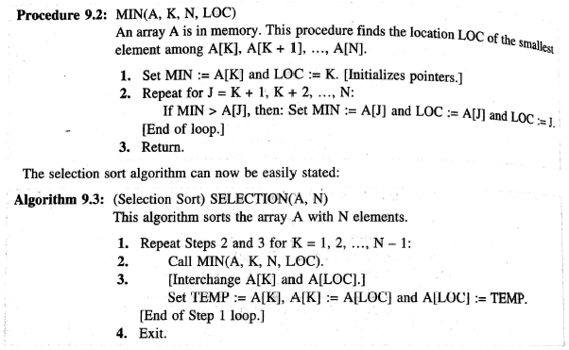

Slide 22
THANK YOU

